Slide 1



React JS Training

Slide 2

Section 1: Set up and Foundations make your machine ready for coding, some JavaScript(JS), Bundlers
Section 2: React Basic Concepts
props, state, virtual dom, hooks, life-cycle of a component
Section 3: React Advanced Concepts
Context api, optimizing performance, refs, accessibility
On Going: Our Food Ordering Application
As we learn, we will keep using the concept in our application

Slide 3

Section 1: Set up and Foundations
Set up the tools
Some basic HTML, CSS and JavaScript
JavaScript concepts needed for React JS
Library vs Framework
Bundlers

Slide 4

Section 2: React JS Basics
What and Why React?
jsx
Basic Building Block of React: Components
Props and State
Lifecycle of React Components
Lists, Keys, Conditional Rendering,
Ternary Operator usage
Data flow
Routing
Forms
React Hooks: useState, useEffect

Slide 5

Section 3: Advanced React JS
Advanced hooks: useref, useCallback, useMemo
Custom hooks
Context API
Code-Splitting
Accessibility
Higher-Order Components
Optimizing Performance
Type Checking
Testing

Slide 6
Section 1: Set up and Foundations
Set up tools:
VS code
Extension: Emmet
Git-repo
Make a simple html, css and js program
Create a folder called hello-world
Create a file called index.htm
Use emmet to create the basic html code
Create a div container with id="root" and add a heading tag h1 inside
Run it on the browser
Let's add some css to it
Let's add some interactivity which is?
Add in git repo: https://gist.github.com/alexpchin/102854243cd066f8b88e
Create the same hello-world using js only

Slide 7
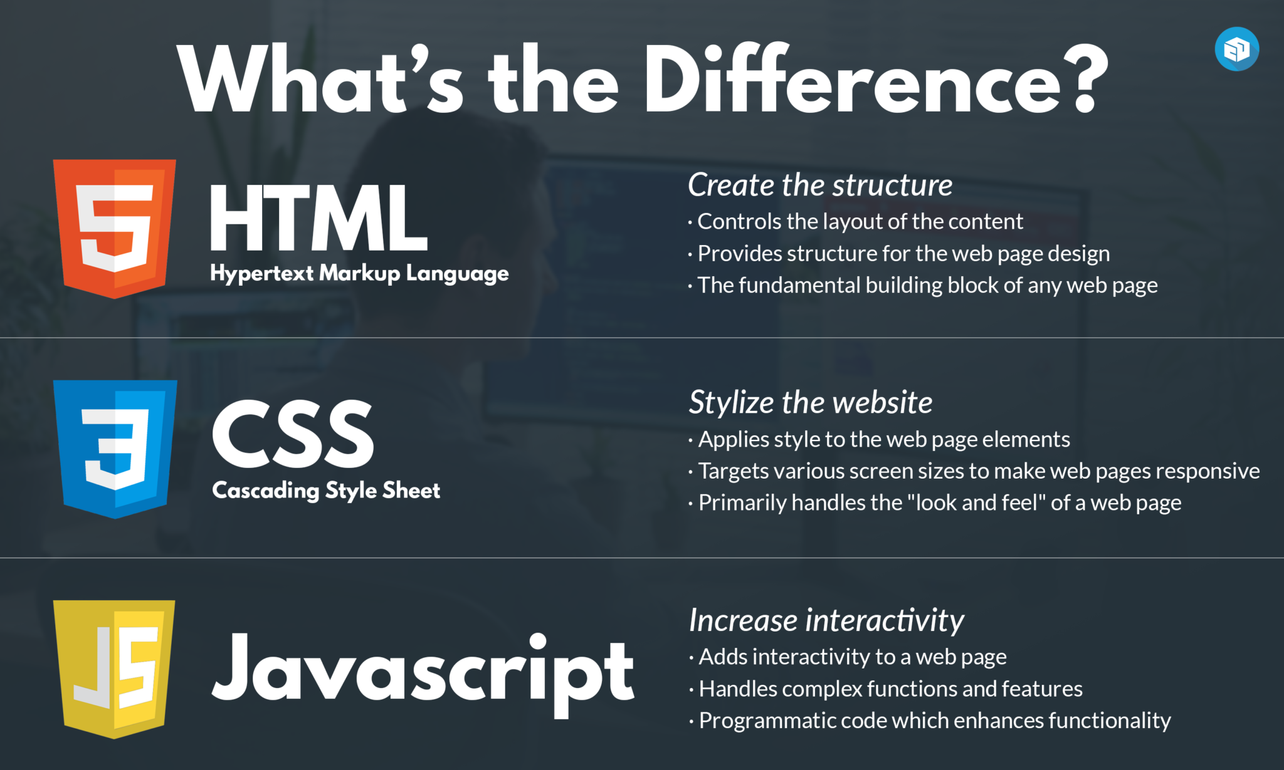
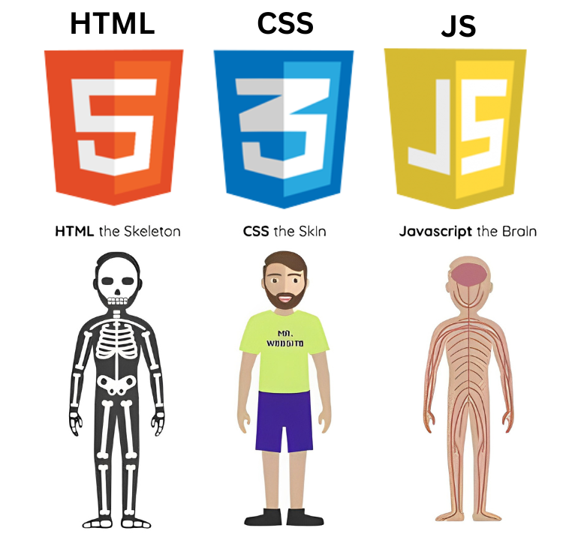
Section 1: Set up and Foundations

Slide 8

Section 1: Set up and Foundations
Role of HTML:
HTML stands for Hypertext Markup Language, and it is the standard markup language used to create web pages.
HTML allows web developers to define the structure and content of a web page using a series of tags and attributes.
HTML tags are used to create elements like headings, paragraphs, links, and images, while attributes provide additional information about those elements.

Slide 9

Section 1: Set up and Foundations
Role of CSS:
CSS stands for Cascading Style Sheets and is used to add visual style and layout to web pages.
CSS allows developers to define colors, fonts, spacing, and other visual elements of a webpage.
CSS can be used to create responsive designs that adapt to different screen sizes and devices.

Slide 10

Section 1: Set up and Foundations
Role of JavaScript:
JavaScript is a programming language that is used to add interactivity and functionality to web pages.
JavaScript allows developers to create dynamic content that responds to user input or changes in the webpage.
JavaScript can be used to create animations, form validation, and other interactive elements on a web page.
JavaScript is a key component of modern web development and is often used in conjunction with HTML and CSS to create dynamic and engaging web pages.

Slide 11
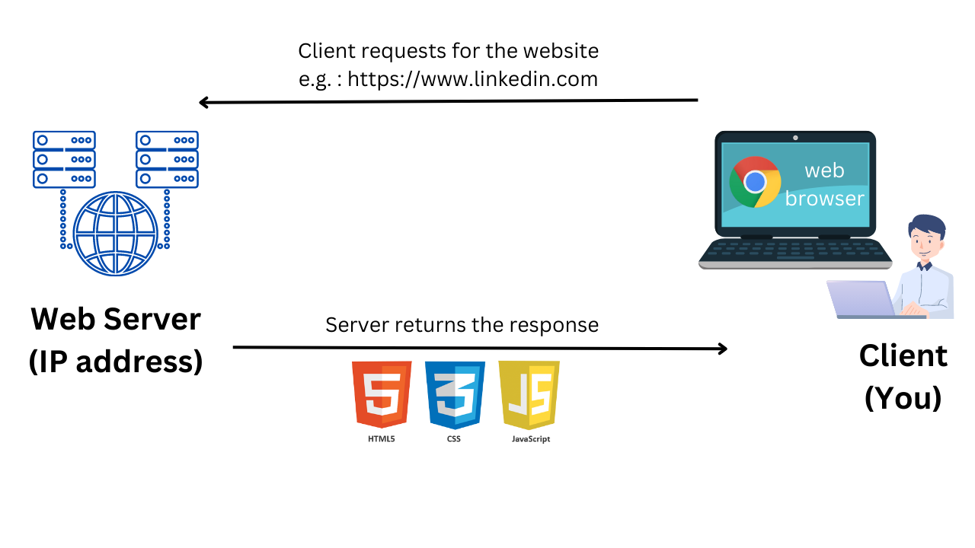
Section 1: Set up and Foundations
How Browsers Works?

Slide 12
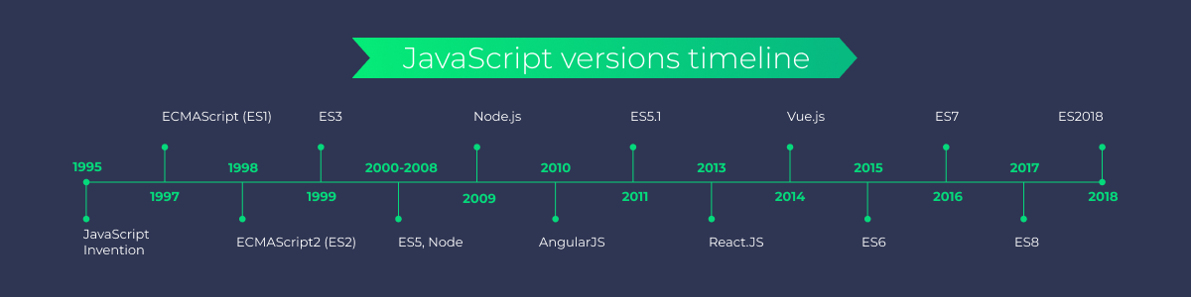
Section 1: Set up and Foundations
JavaScript and ES6
What is ES6?
What is EcmaScript?
ECMAScript is a scripting language specification on which JavaScript is based. Ecma International is in charge of standardizing ECMAScript.
to ensure the interoperability of web pages across different web browsers.
"ECMA" stood for "European Computer Manufacturers Association" until 1994.

Slide 13
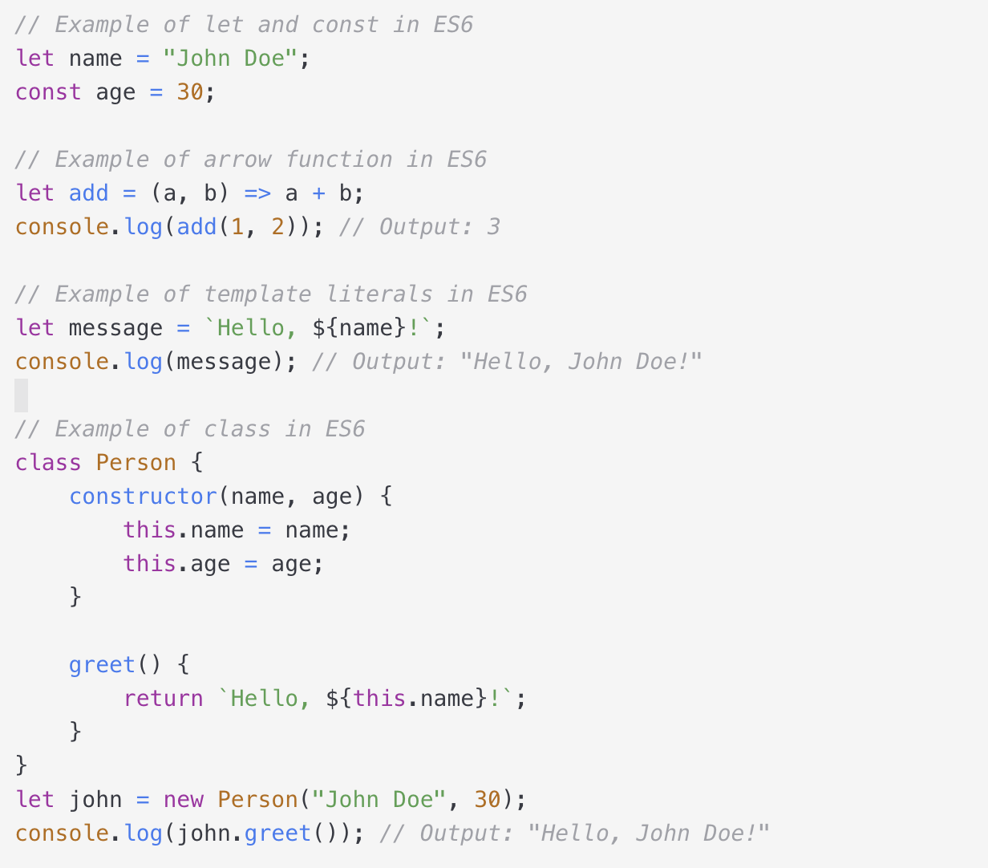
Section 1: Set up and Foundations
ECMAScript 6 (2015)
ECMAScript 6, also known as ES6, was the sixth version of the ECMAScript standard and was released in 2015. It introduced several important features such as let and const, arrow functions, template literals, and classes.

Slide 14
Section 1: Set up and Foundations
JavaScripts Concepts
1. Function Declarations and Arrow Functions
2. Template Literals
3. Short Conditionals: &&, ||, Ternary Operator
4. Three Array Methods: .map(), .filter(), .reduce()
5. Object Tricks: Property Shorthand, Destructuring, Spread Operator
6: Promises + Async/Await Syntax
7. ES Modules + Import / Export syntax

Slide 15
Section 1: Set up and Foundations
Difference between a Library and Framework?
Both frameworks and libraries are reusable code written by someone else to help solve problems in more straightforward ways.
In Libraries, you build your application as you want. But in framework works just use it as the framework desired. In frameworks, you write code less than in Libraries.
Library
A library provides a set of helper functions/objects/modules which your application code calls for specific functionality. It performs a set of specific and well-defined operations.
Framework
The framework has defined open or unimplemented functions or objects which the user writes to create a custom application. It is known to be a skeleton where the application defines the content of the operation by filling out the skeleton.

Slide 16
Section 1: Set up and Foundations
What is CDN? Why do we use it?
A content delivery network (CDN) refers to a geographically distributed group of servers that work together to provide fast delivery of Internet content. The main use of a CDN is to deliver content through a network of servers in a secure and efficient way.
What is node? Npm and yarn
Node allows developers to write JavaScript code that runs directly in a computer process itself instead of in a browser. Node can, therefore, be used to write server-side applications with access to the operating system, file system, and everything else required to build fully-functional applications.
Node “uses an event-driven, non-blocking I/O model.” In practice, this means that Node is built well to handle asynchronous JavaScript code to perform many asynchronous activities such as reading and writing to the file system, handling connections to database servers, or handling requests as a web server.
Npm and yarn are just package managers. Node packages are a convenient way to share modules between Node developers. The service npm is the default package manager for Node, and it ships with an installation of Node.
npm allows access to the hundreds of thousands of open-source packages available.

Slide 17
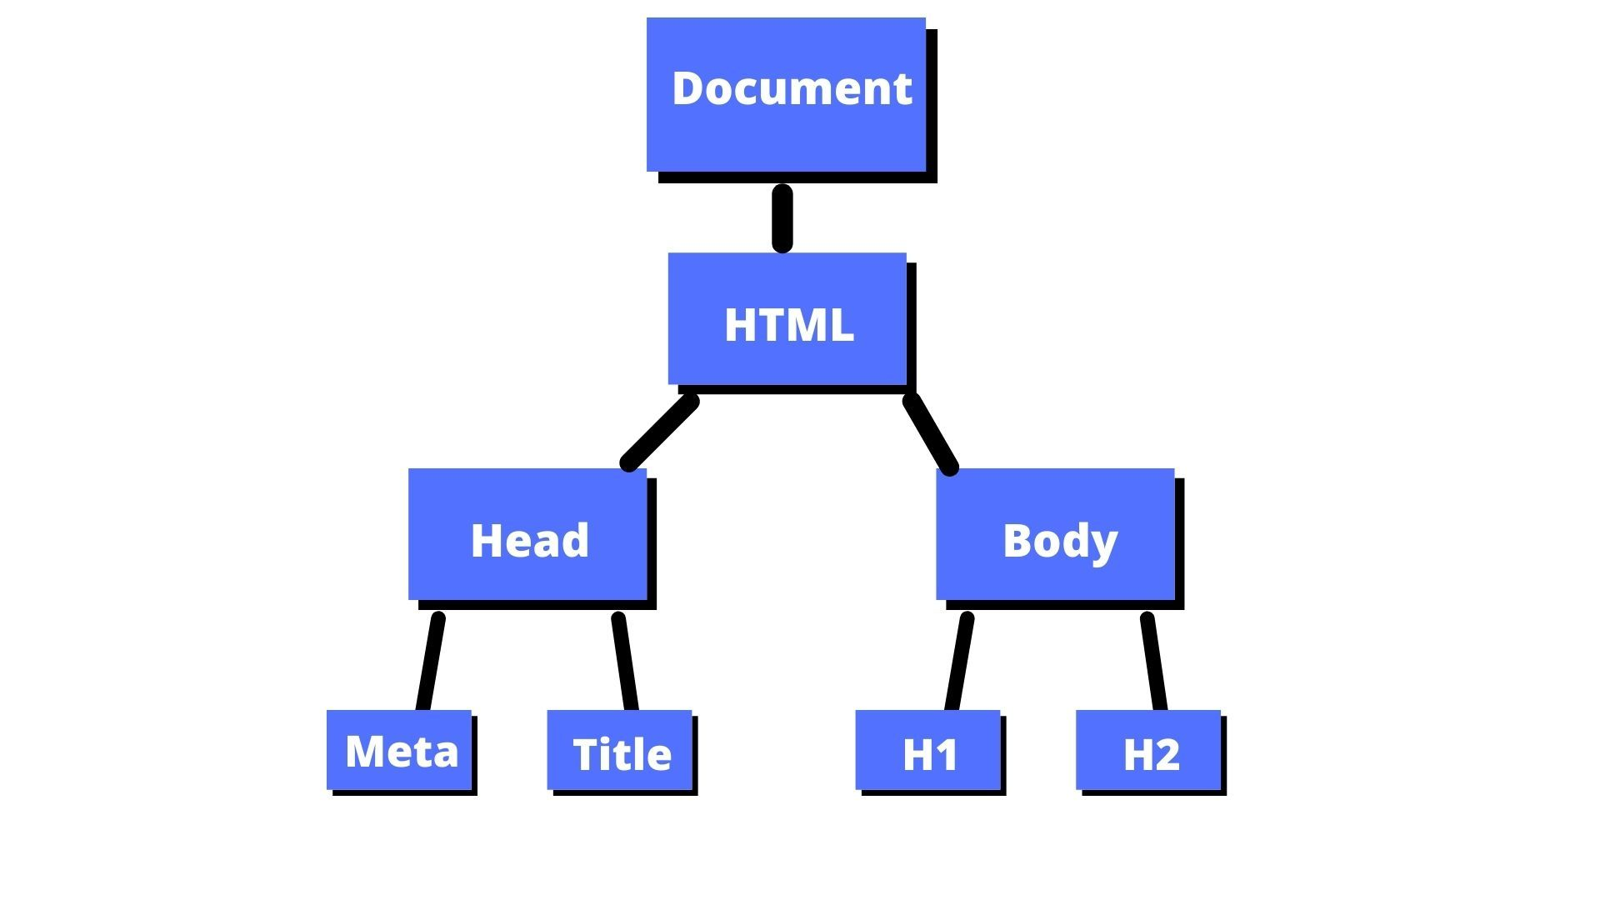
Section 1: Set up and Foundations
What is DOM?
Document Object Model
The data representation of the objects that comprise the structure and content of a document on the web.
It is a programming interface that allows us to create, change, or remove elements from the document.
We can also add events to these elements to make our page more dynamic.
The DOM views an HTML document as a tree of nodes. A node represents an HTML element.
The DOM is not part of the JavaScript language, but is instead a Web API used to build websites.

Slide 18
Section 1: Set up and Foundations
What is a Bundler?
Combines many JavaScript code files into a single production-ready loadable file in the browser
Generates a dependency graph as it traverses your first code files => beginning with the entry point you specified, the module bundler keeps track of both your source files’ dependencies and third-party dependencies.
Many popular module bundlers also come with performance optimization features => Code splitting and hot module replacement. Some with Productivity-enhancing features such as robust error logging
How does a Bundler work?
Dependency graph generation + Eventual bundling

Slide 19
Section 1: Set up and Foundations
What is Parcel/Webpack? Why do we need it?
Parcel/Webpack is type of a web application bundler
Parcel can take any type of file as an entry point, but an HTML or JavaScript file is a good place to start.
Parcel Features:
HMR (Hot Module Replacement) - parcel keeps track of file changes via file watcher algorithm and renders the changes in the files
File watcher algorithm - made with C++
Minification
Cleaning our code
DEV and production Build
Super fast building algorithm
Image optimization
Caching while development
Compresses
Compatible with older version of browser
HTTPS in dev
Port Number
Consistent hashing algorithm
Zero Configuration
Automatic code splitting

Slide 20
Section 2: React JS Basics
What is package.json
Configs for npm
It is needed for managing dependencies/packages
Npm installs
npm install –D parcel
^ and ~
What is package-lock.json?
Keeps track of the exact version which is used.
Locks the version and keeps the record of it
Command: npx parcel index.html
Parcel makes a dev build from index.html

Slide 21
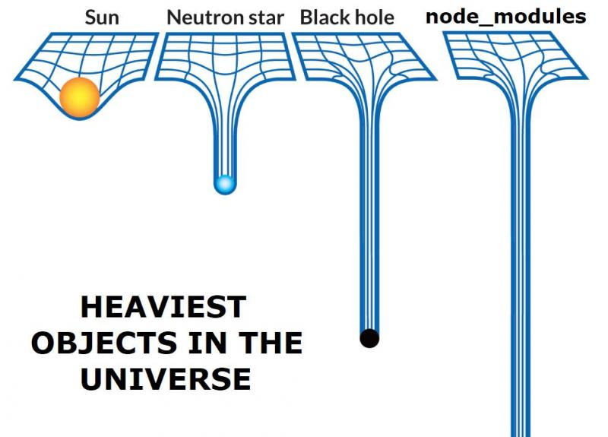
Section 2: React JS Basics
node_modules: fetches all the code of all the dependencies in the application

Slide 22
Section 2: React JS Basics
Component
Everything is a component in react
Class based Component and Functional Component
A react functional component is a function which returns some jsx code or a function which returns a jsx element
A react element is a jsx
Component Composition
Inside {} curly braces inside the react component, we can run js expressions
Initial Work on our Food App

Slide 23
Section 2: React JS Basics
What is React?
What is jsx?:
React can be written without jsx
Jsx makes developers life easy
Jsx is not html inside javascript
Jsx is different than html
Jsx is a html like syntax or xml like syntax
Jsx is not react element, it is just syntax
Js engines/Browsers do not understand jsx as js engine understands ECMAScript
For us parcel transpiles jsx to js, babel does it
Attribute in jsx should be in camelCase
Jsx takes care of the malicious code from injection, it will sanitize
What is Babel?
Converts jsx code to code which react will understand
Install prettier
Install bracket color colourize

Slide 24
Section 2: React JS Basics
Component:
Try breaking into modules whenever you see repetition
Why do create function?
Ways to write css:
Normal css files
Inline styles (given in style attribute using an object in jsx)
Css is written as objects too in jsx
Material-ui, styled-components etc
Why inline css is not a good object?
{{}}: first bracket is telling that there is some js expression inside and second is for the object

Slide 25
Section 2: React JS Basics
Props
Short-hand for properties
Just like arguments passing to a function
It is for passing the dynamic data to the component
How the Backend gives the data?
Install json viewer in chrome
What is Config-Driven UI?
Our website is driven by config/data
Controlling the ui from the data(comes from backend)
UI is written once
UI can be in different countries/cities
E.g red color background in Delhi, red in Kolkata
You should be able to discuss the data with the BE
UI Layer + Data Layer

Slide 26
Section 2: React JS Basics
Optional Chaining
Loop over the array to dynamically create child components
Can be used for dynamic number of objects in list
Can be done using .map method of array
For loop can be used too
Array functions .map, .filter and .reduce
In jsx, we are doing markup and js both
Key warning in console for list
always give the key
Why??
Huge optimization
Should indexes be used as key?: official documentation(https://legacy.reactjs.org/docs/lists-and-keys.html): interview question

Slide 27
Section 2: React JS Basics
Best Practices in the industry
Not a good practice to use large files
multiple files
src folder
separate files for every component
components folder: component level code
File Name => Component inside the file
File .jsx or .js
Utils: utilities which can be used anywhere in the app
Never keep hard coded data in the component folder
Component file with capital letter
Constants in capital letters and snake case
https://legacy.reactjs.org/docs/faq-structure.html

Slide 28
Section 2: React JS Basics
Two types of export and import
default export/import
export default Component
import Component from 'path'
Named export/import
export const Component
import {Component} from 'path'
One file can have only one default export but many named exports
Event Handlers in React
e.g: onClick which takes callback
Data layer and UI Layer in sync
Update the DOM easily
Fast DOM manipulation

Slide 29
Section 2: React JS Basics
Hooks
A hook is just a normal js function given by react
Utility function by react
Two important hooks: useState and useEffect
useState
state variable
Imported as named import from react library
Somebody would have exported in React that's why we are able to import
Maintains state of a component, its scope is inside the component
useState has the ability to encapsulate local state in a functional component
useState returns an array which has the state variable
Cannot be modified normally but by a function given by useState only
Whenever a state variable updates, React re-renders the component
Re-render: React will remove the component and re-create it
As soon as my data layer changes, UI layer changes
React does it pretty fast by making DOM Manipulations fast and efficient=> Core logic

Slide 30
Section 2: React JS Basics
Reconciliation Algo/React Fiber
React does not touch the actual DOM a lot
https://github.com/acdlite/react-fiber-architecture
What is Monolith and Microservice Architecture
Microservice
Difference service for different work like db, ui, sms, email etc
Separation of concern/single responsibility principle
All services talk to each other
Different tech for different micro services
How will a react app make an api call?
When to do an api call?
As soon as the page loads, wait for data to come and then render the data
As soon as the page loads, render the skeleton, make the api call and then re-render
Reacts rendering cycles are very fast

Slide 31
Section 2: React JS Basics
Hook is a normal js function
useEffect intro
Takes two arguments: callback function and dependency array
useEffect(() => {}, []);
useEffect helps in the 2nd approach
Cors policy
if there is a origin mismatch, browser doesn't let us call the api
Is showing a spinner a good way?
Shimmer UI?
Resembles the actual ui
We load fake page until we get the actual data from the api
Latest practice
Youtube follows
Swiggy follows

Slide 32
Section 2: React JS Basics
Conditional rendering
Using a ternary operator
Why we can't use the local js variable
React will not be able to track
Whenever the state variable changes, react re-renders the component, triggers the reconciliation cycle
Does react changes the whole component or just the div or tag with state?
How the const useState variable is modified?
Rendering => calling the component/function
Assignment:
Make a login button and toggle it from login to logout and vice-versa

Slide 33
Section 2: React JS Basics
Bind the value to a local state variable
Important: Whenever the state updates, the whole component re-renders by react.
DOM manipulation is expensive so react re-renders the component but updates only the diff element(portion) in the DOM
useEffect:
dependency array is not there: useEffect is called after every render
dependency array is empty: useEffect is called once after the first render
dependency array is there: useEffect is called everytime the dependency changes
useState:
It is a good practice to create the state in the start of the component
Don't use it inside the if-else/loops/functions: creates inconsistencies

Slide 34
Section 2: React JS Basics
Routing
Different pages on different url
react-router-dom library
createBrowserRouter
RouterProvider
useRouterError
Children routes
Outlet
Using Link, we can go to the different without re-loading page
Don't use a/anchor tag for react
The whole page gets refreshed
Why react is called Single Page Application(SPA)
Types of Routing in webapps
Client Side Routing: no network calls for getting pages
Server Side Routing: pages come from network calls

Slide 35
Section 2: React JS Basics
Dynamic Routing
useParams hook
Link is a wrapper over anchor tag, with Link, react-router-dom keeps the track of the particular link so as to not refresh the page
Single Responsibility Principle
Modularity: breaking code into small modules
Becomes more maintainable
More testable
More reusability
Components should be light
Custom hooks

Slide 36
Section 2: React JS Basics
Custom Hooks
Hooks are like utility functions
Create a separate folder
React will track this too
Makes code cleaner
Finalize the contract: input => output
Is using 'use' necessary for naming custom hooks?
Helpful for other devs to understand
Makes them understand that it is not a normal function but a hook which has its own react life cycle
Optimizations
What is bundling?
Takes all js files and convert it into one js file
Is it good to have one js file?: size will be a lot
Js file increases by how much components are there
Solution: smaller bundles of one file called chunking/code-splitting/lazy loading

Slide 37
Section 2: React JS Basics
Bundling
Logical splitting into smaller bundlers in which one bundle can act as one feature
One bundle should not be very heavy to get into our browser
Chunking
Other names: lazyy loading, code-splitting, dynamic bundling, on-demand loading, dynamic import
The code will only come when requested
Lazy function by react
Suspense

Slide 38
Section 3: React JS Advanced
Higher Order Components/HOC
HOC is a function which takes a component and returns a component
It adds some extra features to the input component
Why?
HOC components are pure functions
Will not modify the behaviour of the input component
UI layered(jsx) is powered by data layer(props, state, local variables)
Class Component
State
Render
ComponentDidMount
ComponentDidUpdate
ComponentDidUnmount

Slide 39
Section 3: React JS Advanced
memo : a HOC a component that takes a component as a prop and returns a component that prevents a component from re-rendering if the props (or values within it) have not changed.
useRef
Skips re-render
Updates the dom directly
Should not be used if not necessary
useCallback
What useCallback does is memoize the returned function object based on the provided dependencies.
This means that given the same dependencies (compared by reference) it returns the same function object (which can now be used for more reference comparisons and match the previously returned function).
One or two unnecessary useCallbacks/useMemos are no big deal - but when they’re everywhere, and they do nothing it can become a problem.
they add up to longer render times and more memory usage
If the component or hook to which you’re passing this useCallback()‘ed function to doesn’t care whether or not it has been given a new function, instead of just creating a new function, you’ve now: created a new function, created a new array, invoked a function (useCallback), and caused React to compare equality of the dependencies and store the function and new set of dependencies into memory.
When should I use useCallback and useMemo
Referential equality
Computationally expensive calculations

Slide 40
Section 3: React JS Advanced
useMemo
lets you cache the result of a calculation between re-renders.
Difference between useMemo and useCallback
Use useMemo when you want to optimize and cache the result of a computation that depends on certain inputs.
Use useCallback when you want to optimize the creation of callback functions that are passed to child components.
Controlled and Uncontrolled Components
Controlled components refer to the components where the state and behaviors are controlled by Parent components while Uncontrolled components are the ones having control of their own state and manage the behaviors on themselves.
In practice, “controlled” and “uncontrolled” aren’t strict technical terms—each component usually has some mix of both local state and props.
When writing a component, consider which information in it should be controlled (via props), and which information should be uncontrolled (via state). But you can always change your mind and refactor later.

Slide 41
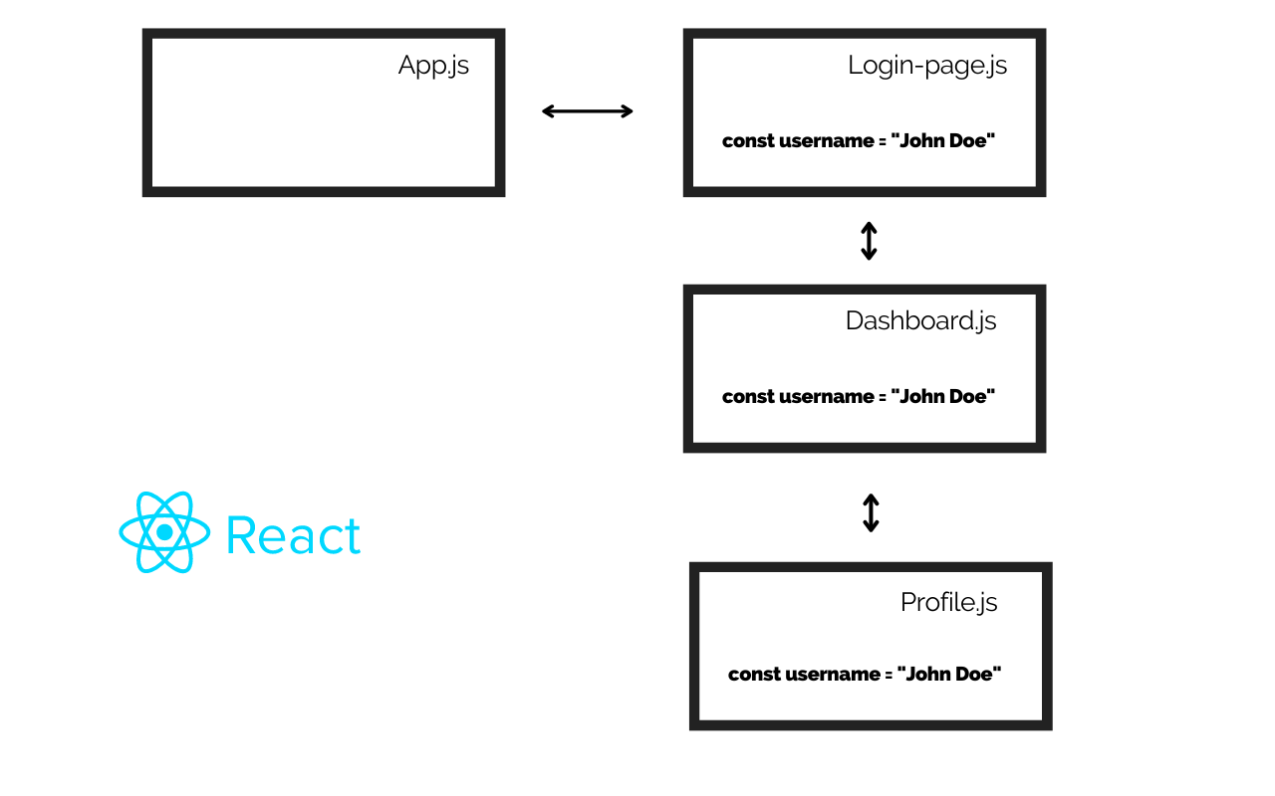
Section 3: React JS Advanced
Prop-Drilling:
Prop drilling is a situation where data is passed from one component through multiple interdependent components until you get to the component where the data is needed.
Passing data through multiple components is not a good way of writing clean, reusable, and DRY code.

Slide 42
Section 2: React JS Basics
React Context API
The React context API is a fast way of avoiding prop drilling and ensuring your data is managed globally without using a huge third-party state management app like Redux and MobX.
TypeScript
TypeScript is a superset of JavaScript, meaning that it does everything that JavaScript does, but with some added features.
The main reason for using TypeScript is to add static typing to JavaScript. Static typing means that the type of a variable cannot be changed at any point in a program. It can prevent a LOT of bugs!
JavaScript is a dynamically typed language, meaning variables can change type.
// JavaScript let foo = "hello"; foo = 55; // foo has changed type from a string to a number - no problem // TypeScript let foo = "hello"; foo = 55; // ERROR - foo cannot change from string to number

Slide 43
Section 3: React JS Advanced
Accessibility
Making the site usable by people with special abilities, mobile screens, with slow networks etc
React hook form
How to structure React Project
https://dev.to/larswaechter/how-i-structure-my-react-projects-jii
https://legacy.reactjs.org/docs/faq-structure.html
Removing unwanted React imports https://legacy.reactjs.org/blog/2020/09/22/introducing-the-new-jsx-transform.html#removing-unused-react-imports
Do we still have Class in React?
https://react.dev/reference/react/Component

Slide 44
Fun Facts
JavaScript was BORN in just 10 days
In 1995, Brendan Eich, a Netscape Communications Corporation employee, was tasked with creating a scripting language for Netscape Navigator, one of the earliest web browsers. He developed the language in just 10 days, originally naming it “Mocha.” Later, it was renamed “LiveScript” and finally settled on “JavaScript” to capitalize on the popularity of Java, a programming language of that time.

Slide 45
References
https://medium.com/@pasinduanuhas/5-fun-facts-about-javascript-adf3c9cf0d74
https://www.linkedin.com/pulse/building-blocks-web-development-html-css-javascript-sahil-kavitake/
https://www.freecodecamp.org/news/javascript-skills-you-need-for-react-practical-examples/
https://developer.mozilla.org/en-US/docs/Glossary/ECMAScript
https://webreference.com/javascript/basics/versions/
https://medium.com/@feruzTeame/difference-between-library-and-framework-d4c255579bee
https://www.codecademy.com/article/what-is-node
https://www.freecodecamp.org/news/what-is-the-dom-document-object-model-meaning-in-javascript/
https://snipcart.com/blog/javascript-module-bundler
https://developer.mozilla.org/en-US/docs/Web/API/Document_Object_Model/Introduction
https://developer.mozilla.org/en-US/docs/Web/Events/Event_handlers

Slide 46
References
https://royi-codes.vercel.app/thousand-usecallbacks/
https://kentcdodds.com/blog/usememo-and-usecallback
https://blog.isquaredsoftware.com/2020/05/blogged-answers-a-mostly-complete-guide-to-react-rendering-behavior/
https://react.dev/learn/sharing-state-between-components
https://react.dev/reference/react/useMemo
https://www.freecodecamp.org/news/avoid-prop-drilling-with-react-context-api/
https://react.dev/learn/sharing-state-between-components#controlled-and-uncontrolled-components
https://www.freecodecamp.org/news/learn-typescript-beginners-guide/
https://www.freecodecamp.org/news/context-api-in-react

Slide 47

Thank You

